Slide 1
Network Password Standards
Turning on complexity measures
Dave Gates – Director of ITS Operations

Slide 2
What will be changing?
CURRENT Standard
NEW STANDARD
No password re-use restrictions
Minimum length of 6 characters
No complexity controls
Cannot reuse your past 5 passwords
Minimum length of 8 characters
Must contain 3 of the 4 complexity controls
Upper case
Lower case
Number
Special character such as !@#$%^&()

Slide 3
Why is this work being done?
The change in password standards will do the following:
Protect CCC student information from malicious intrusions
Create consistency in password expectations
Enforce tighter security measures to comply with PCI standards
The longer a password is, the more secure it is.
6 character passwords can be cracked in a few seconds
8 character passwords in less than a day
A long passphrase can take decades or longer to crack.

Slide 4
When is this happening?
ITS will implement this change on 2 Nov
Are there any concerns with this?
This will NOT require anyone to change their password sooner than normal
Mandatory password changes are still 180 days

Slide 5
Who will be impacted?
CCC staff and faculty
Students
Looking for feedback on how to best communicate to these groups

Slide 6
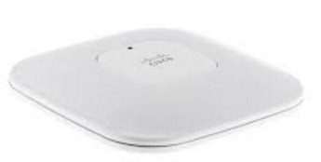
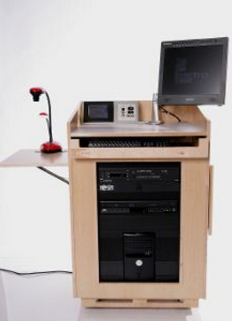
podium retrofits
Internet
Podium to projector connection will be hardwired for improved reliability
Rooms with most reported problems first
Mcloughlin 204, 206, 255, 257
Harmony Mod 2, 4, 5, 7
Barlow 151, 152a, 153
Training Center 104, 118, 120
Streeter 134

Slide 7
Wireless modernization
Removed all old wireless access points
Should resolve “IP address conflict” error messages
Improves speed and reliability by preventing conflict between old and new systems
Installed 210 new state of the art access points this summer
Total of 286 (including last year’s updates) on all three campuses
Indoor wireless coverage should be virtually universal
Outdoor wireless should cover most heavy traffic areas
Please help us with a service request for important areas with poor coverage

Slide 8
Community Center wireless Heat Map
Usable Range
Installed Range

Slide 9
Questions / comments?

